Slide 1
Digital Portfolio
STUDENT NAME: VARSHINI.M
REGISTER NO AND NMID: 212402110/asunm293212402110
DEPARTMENT: BCA-COMPUTER APPLICATION
COLLEGE NAME: VIDHYA SAGAR WOMEN’S COLLEGE

Slide 2
MY PORTFOLIO BY VARSHINI.M

Slide 3


AGENDA
Problem Statement
Project Overview
End Users
Tools and Technologies
Portfolio design and Layout
Features and Functionality
Results and Screenshots
Conclusion
Github Link
3/21/2024 Annual Review

Slide 4

PROBLEM STATEMENT
1. Students need a way to present their skills and achievements online.
2. Traditional resumes lack interactivity and design.
3. Employers prefer quick access to digital portfolios.
4. Showcasing projects with visuals is difficult in paper resumes.
5. Lack of a personal platform reduces visibility of talents.
6. A responsive website can act as a 24/7 professional showcase.

Slide 5

PROJECT OVERVIEW
The project is a personal portfolio website.
Built using HTML, CSS, and JavaScript.
Provides sections like About, Skills, Projects, and Contact.
Features smooth navigation and user-friendly layout.
Implements a simple contact form with validation.
Uses clean design for readability and attractiveness.
Designed for both desktop and mobile devices.

Slide 6

WHO ARE THE END USERS?
Students showcasing academic and technical work.
Fresh graduates applying for internships or jobs.
Professionals building an online presence.
Recruiters and employers reviewing candidate skills.
Educators evaluating student project submissions.

Slide 7

TOOLS AND TECHNIQUES
HTML5 – for webpage structure.
CSS3 – for styling and layout.
JavaScript – for interactivity and form validation.
Flexbox/Grid – for responsive design.
Google Fonts – for modern typography.
Animations & Transitions – for user engagement.
CodePen/VS Code – for development and testing.
Browser DevTools – for debugging and optimization.

Slide 8
POTFOLIO DESIGN AND LAYOUT
Header with profile image and name.
Navigation bar with smooth scrolling.
About Me section with introduction text.
Skills section presented in styled boxes or lists
Projects section with individual cards.
Contact section with form fields.
Footer with copyright and acknowledgments.
8

Slide 9
FEATURES AND FUNCTIONALITY
Responsive layout for different screen sizes.
Interactive navigation links.
Typing animation/visual effects for introduction.
Skills and projects displayed in organized format.
Contact form with validation using JavaScript.
Smooth user experience with clean design.

Slide 10


RESULTS AND SCREENSHOTS
3/21/2024 Annual Review
10

Slide 11
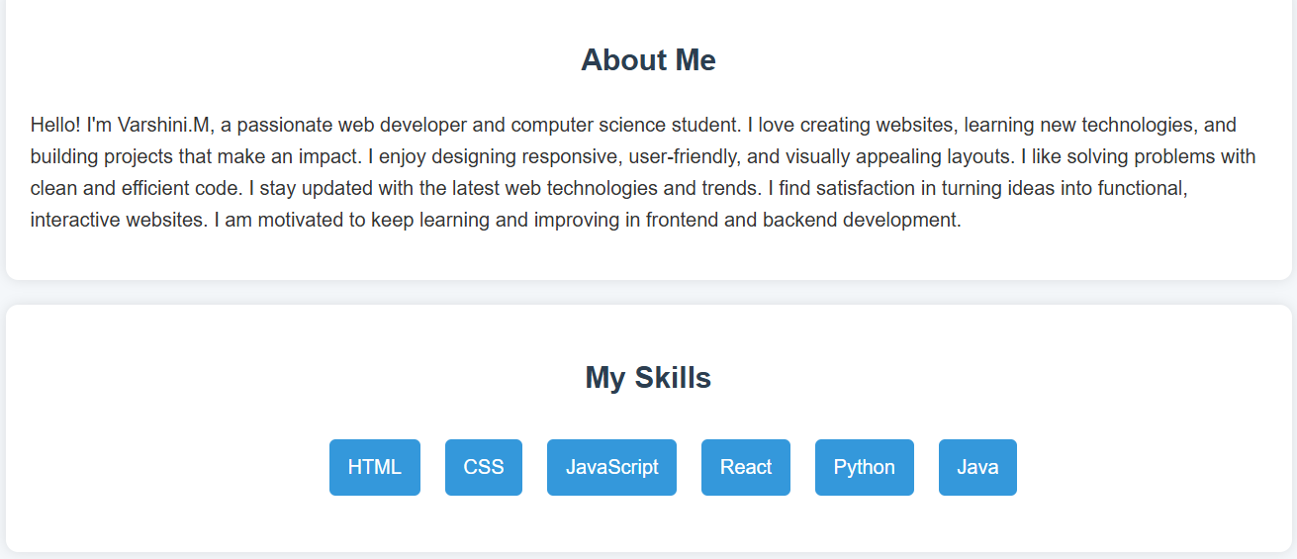
RESULTS AND SCREENSHOTS
3/21/2024 Annual Review
11

Slide 12
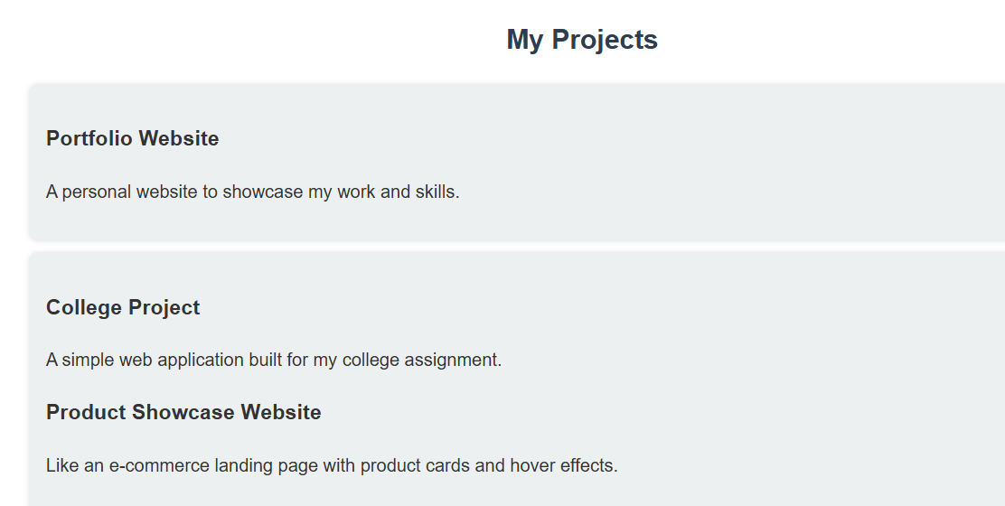
RESULTS AND SCREENSHOTS
3/21/2024 Annual Review
12

Slide 13
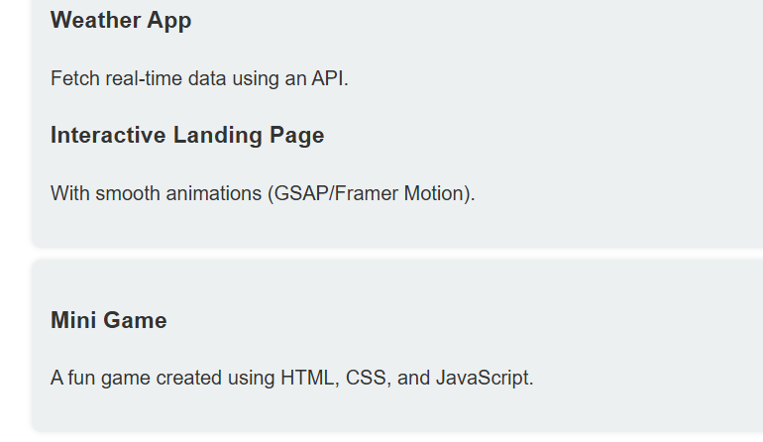
RESULTS AND SCREENSHOTS
3/21/2024 Annual Review
13

Slide 14
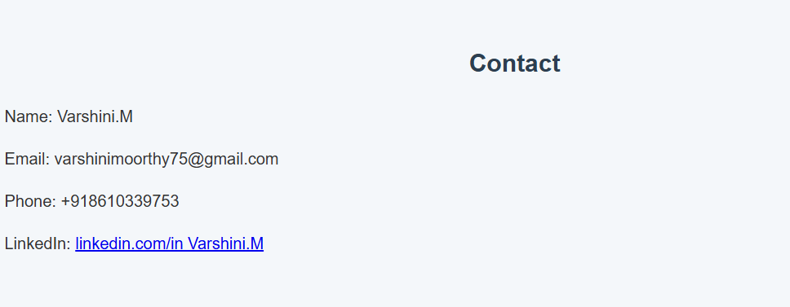
RESULTS AND SCREENSHOTS
3/21/2024 Annual Review
14

Slide 15
CONCLUSION
This portfolio project provides a modern and professional platform for students and professionals to showcase their skills, achievements, and projects. By combining HTML, CSS, and JavaScript, the website offers a responsive, interactive, and visually appealing design. The portfolio not only functions as a digital resume but also highlights creativity through well-structured sections such as About, Skills, Projects, and Contact. With user-friendly navigation and engaging visuals, it serves as an accessible medium for recruiters, educators, and peers to evaluate one’s abilities. Overall, the portfolio enhances visibility, builds credibility, and reflects technical as well as design proficiency.
15

